Slide 1
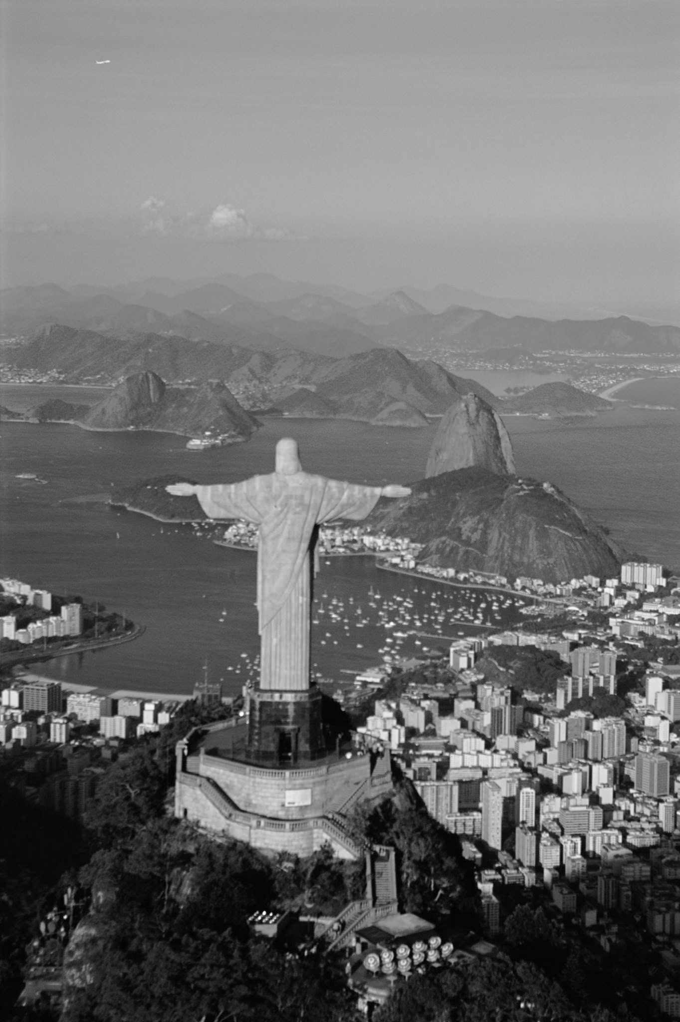
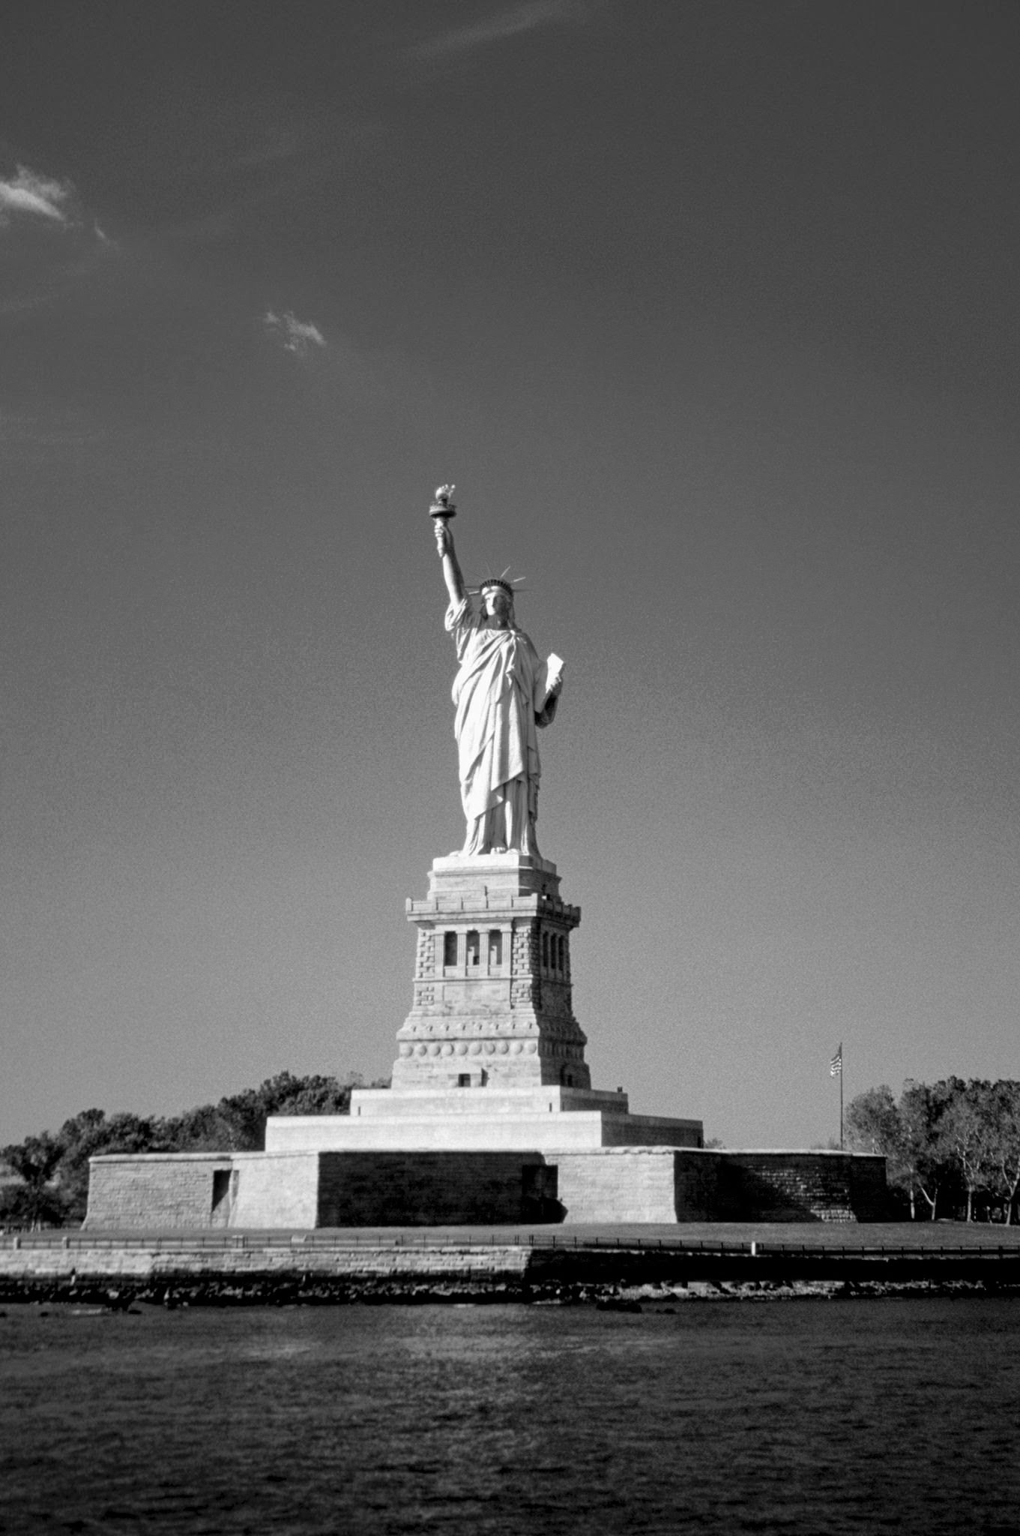

Tax Identification Numbers of the World
T
I
N
Receita Federal do Brasil

Slide 2
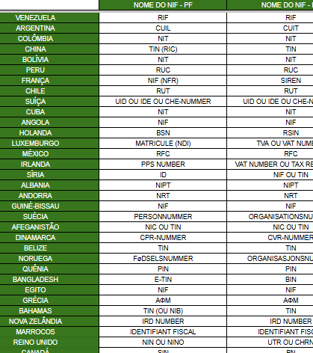
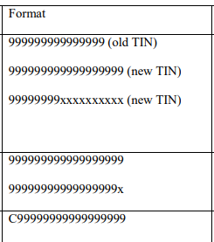
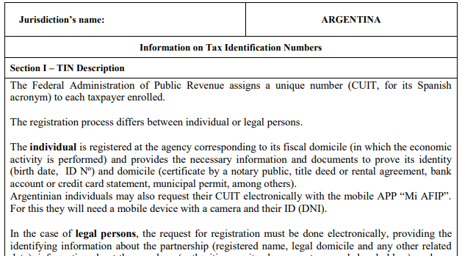
Overall quantity
Total number of countries analyzed: 63

Slide 3

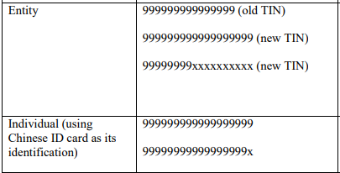
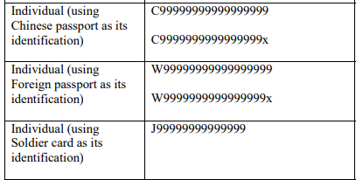
Alphanumeric format
Numeric
format
22 (35 %)
41 (65 %)

Slide 4

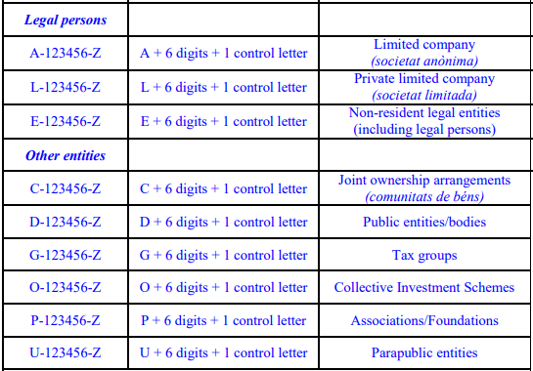
With
Use of prefixes
Without
24 (38 %)
39 (62 %)

Slide 5
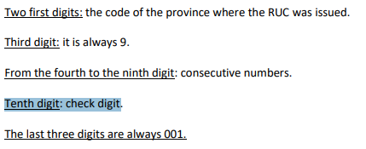
With
Check digit
Without
54 (86 %)
9 (14 %)

Slide 6
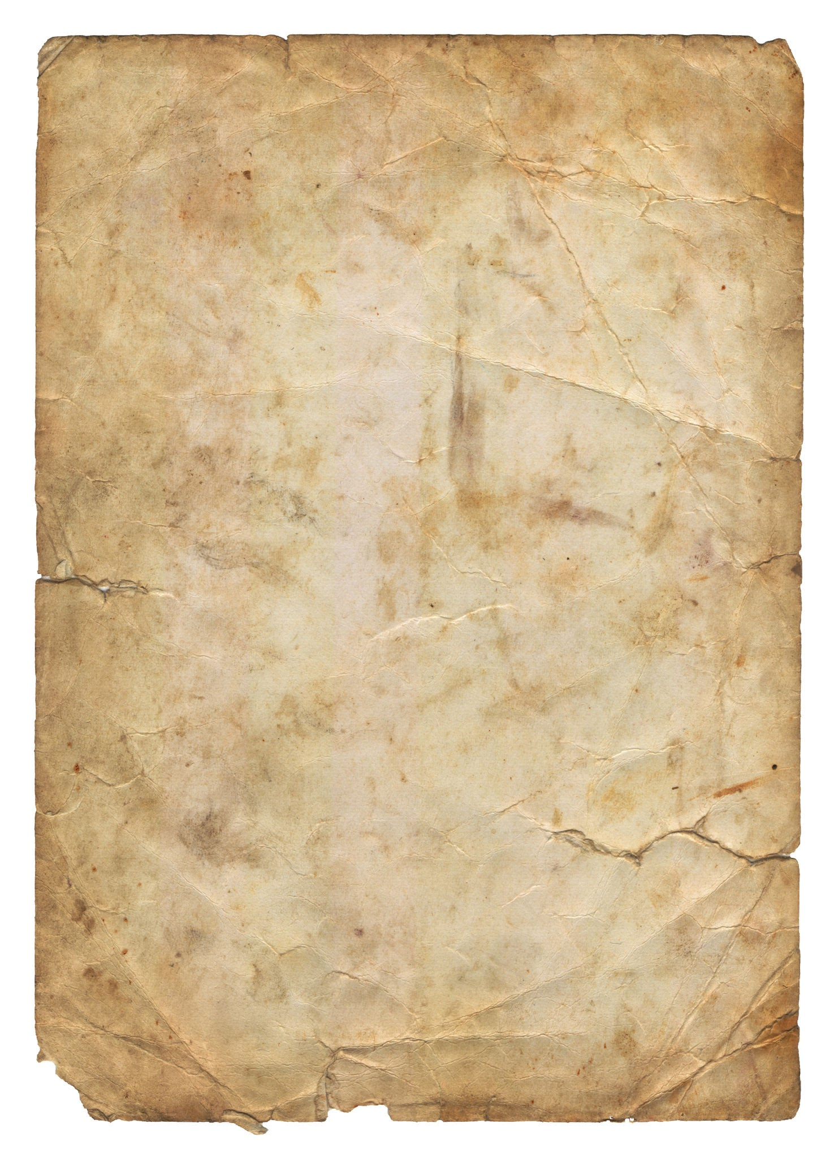
Yes
Historical changes
No
54 (86 %)
9 (14 %)

Slide 7

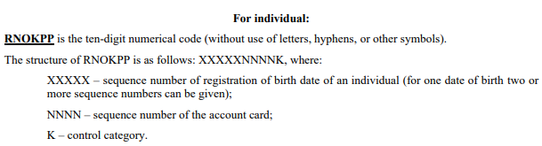
Yes
Date of birth
No
13 (21 %)
50 (79 %)

Slide 8

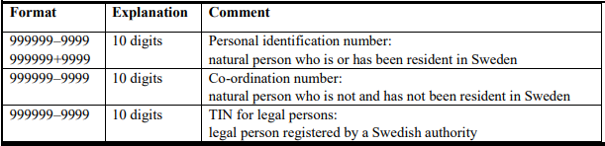
Individuals vs. Legal Entities
63 (100%) report different fields for individuals and legal entities
16 (25%) have both alphanumeric PF and PJ
41 (65%) use the same name for PF and PJ
40 (63%) maintain the same number of digits for PF and PJ

Slide 9

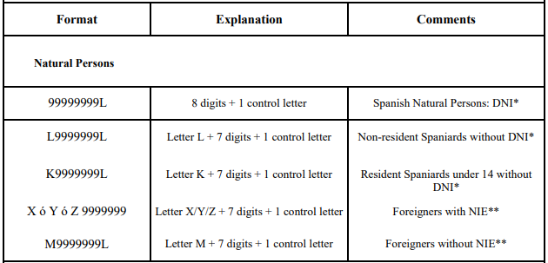
Length standards
The “8 digits + 1 check digit” pattern is the most common.

Slide 10
Suggested practices
Validating letters may require normalization logic (e.g., Unicode vs. ASCII), while purely numeric ones are processed faster.
Systems must capture and distinguish these prefixes to prevent ambiguity between jurisdictions or types of person.
Validating letters may require normalization logic (e.g., Unicode vs. ASCII), while purely numeric ones are processed faster.
The vast majority allows consistency checking, increasing robustness against typing errors through the check digit.
Regarding historical changes, it is necessary to version or maintain legacy rules for a small group of countries.
About the date of birth, in addition to identifying, they allow validating the age range, but require additional extraction and age calculation logic.

Slide 11
Suggested practices
Validating resident and non-resident profiles may require different procedures in almost 1 in 5 jurisdictions.
86% of countries already use DV; implementing universal algorithm (Mod 10/11, ISO 7064) will increase reliability.
Modularize prefix identification (e.g., “BR”, “PT”, “BE-VAT”) to allow extensibility.
Normalize input (uppercase, accent removal) and use generic regular expressions.
Maintain history for countries that “changed over time” (13%), recording the validity of each rule.
For countries that embed date (21%), present proof of concept for age extraction and calculation.

